Slide 1
Pressing Buttons with a Tap: Automating Digital Prepaid Keypad Energy Meters via Mobile App Interface
Supervised By
Priyo Nath Roy
Assistant Professor
Department of Mechatronics Engineering
Khulna University of Engineering & Technology
Presented By
Abdullah Al Rakib
Roll :1931014
Year : 3rd Semester :2nd Batch :2019
Department of Mechatronics Engineering
Khulna University of Engineering & Technology(KUET)

Slide 2
Problem Description
The current method of manually entering prepaid keypad energy meter recharge token requires users to be physically present in front of the meter to press the corresponding buttons.This can be inconvenient for users who are away from home or who have limited mobility.

Slide 3
Objectives
To create an automated system that eliminates the need for manual button pressing in a specialized application.
To create a mobile app for remote system control.
Building a solution that scales while being cost-effective.
To offer users increased control and flexibility over the system.
To improve efficiency in general for the process.

Slide 4
Introduction
Postpaid meters come with their own complications, such as the need to manually insert the printed prepaid energy token into the keypad meter by pressing keys.
The main focus of this project is to automate the manual button pressing by integrating a module and mobile app interface.

Slide 5
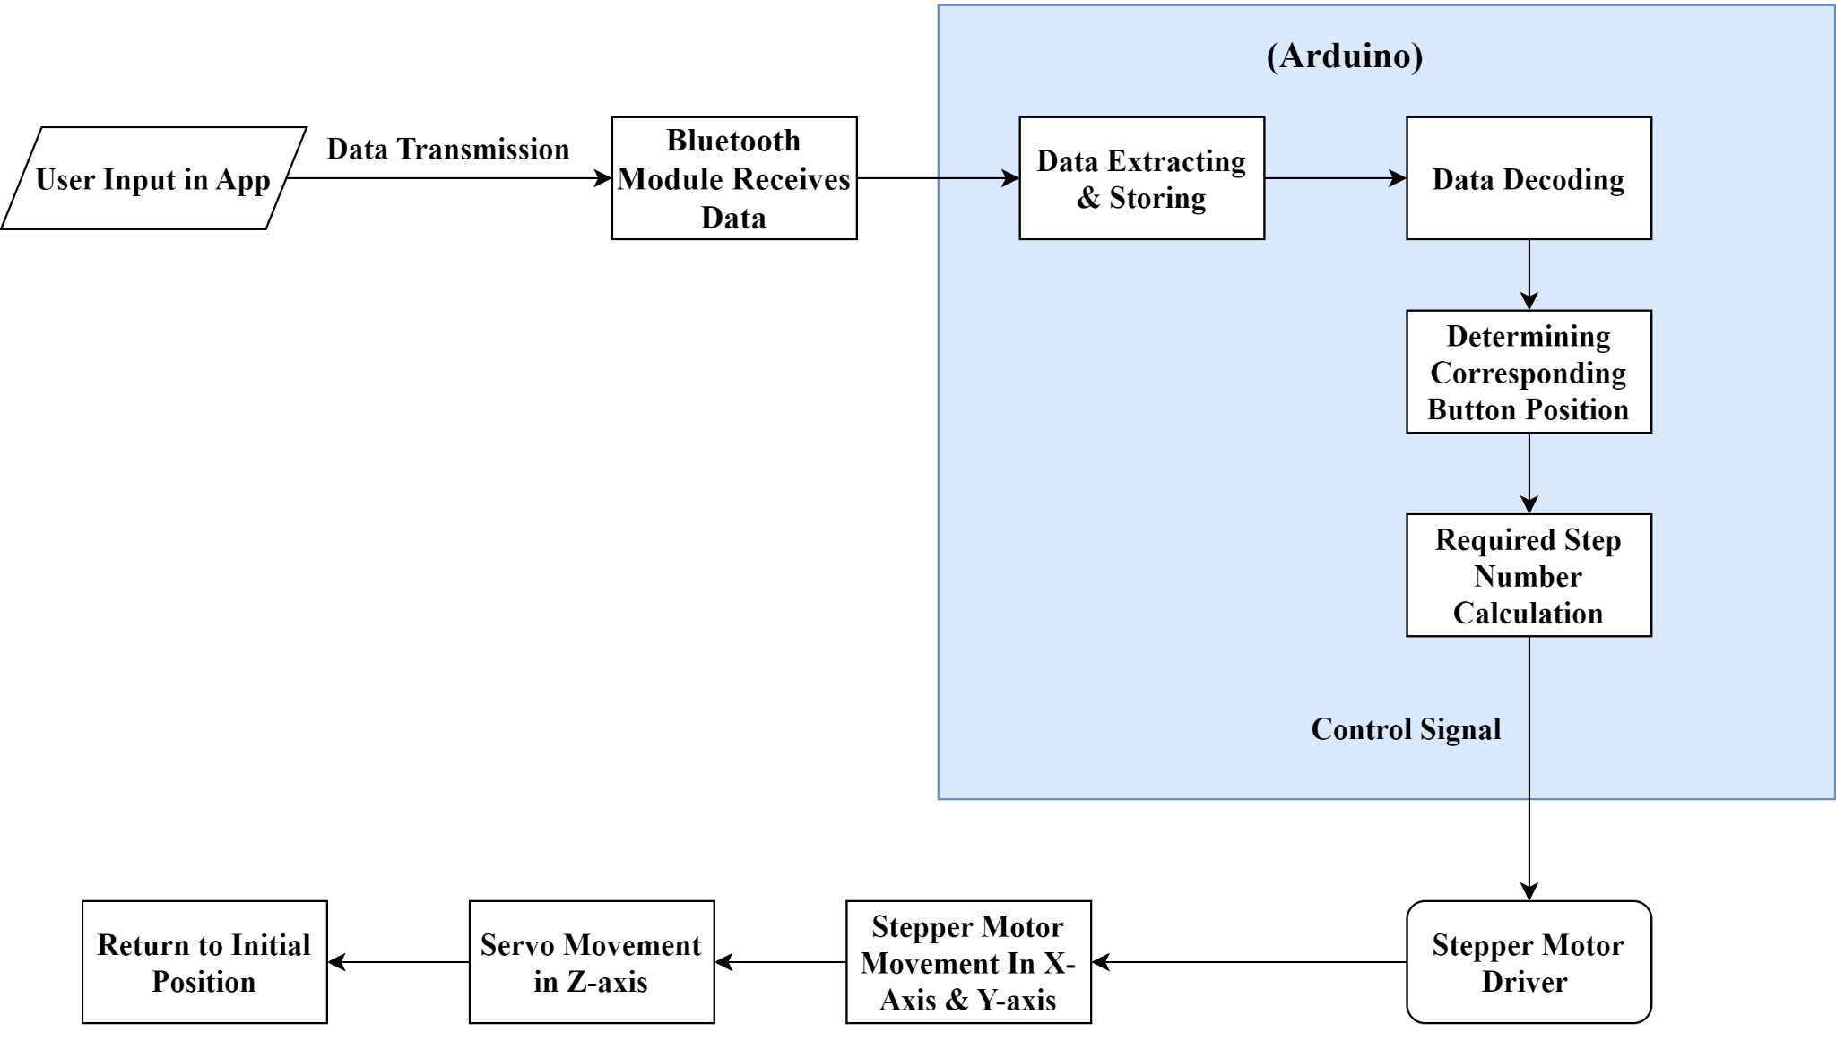
Methodology

Slide 6
Implementations Considerations
Calibrate stepper motors and servo for precise button presses.
Load consideration on linear slider while calculating step number.

Slide 7
Component List & Cost Breakdown
SL No. | Components | Quantity | Cost
1 | 12V Stepper Motor Stroke 80Mm With Slider Motor | 02 | 3600 TK
2 | SG90 Tower Pro Servo Moto | 01 | 150 TK
3 | Arduino Uno | 01 | 700 Tk
4 | Bluetooth Module(HC 06) | 01 | 300 TK
5 | L298N Dual Motor Controller Module | 02 | 350 TK
6 | Miscellaneous |  | 200 TK
 | Total Cost |  | 5300 TK

Slide 8
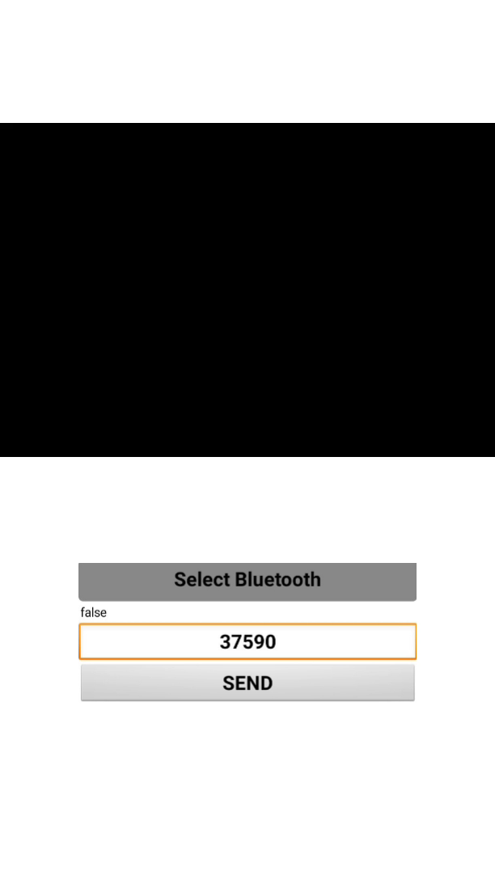
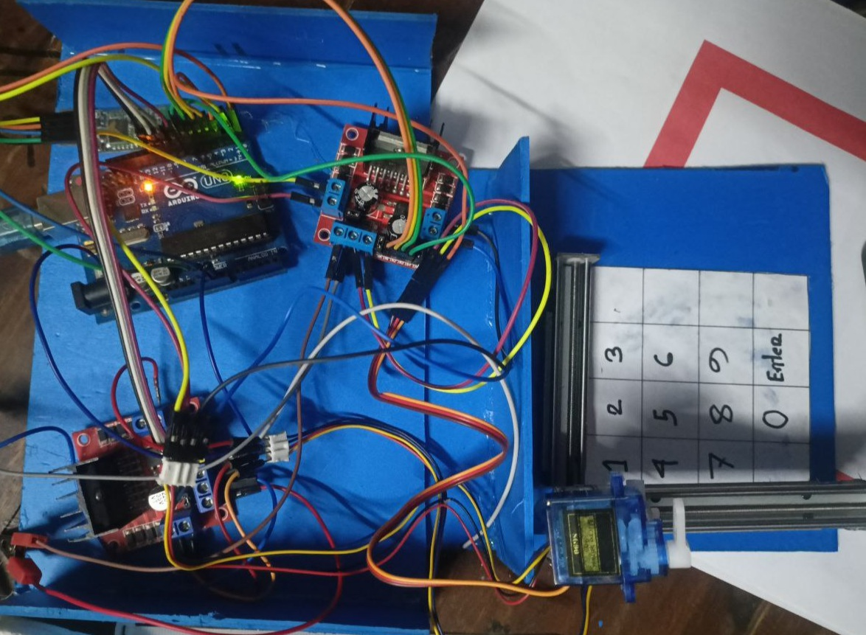
System Demonstration

Slide 9
Future Enhancements
Explore Wi-Fi module for wider range and more reliable communication.
Implement feedback mechanism to compensate for missed steps in x, y-axis.
use of more precise and compact linear movement components.

Slide 10
Conclusions
In conclusion, this project will provide an automated solution to an existing system and offer the convenience of controlling the system from a mobile application ensuring the improved efficiency of the system and make it more accessible to users.

Slide 11
Thank You

